Slide 1
Vaccinations

Slide 2
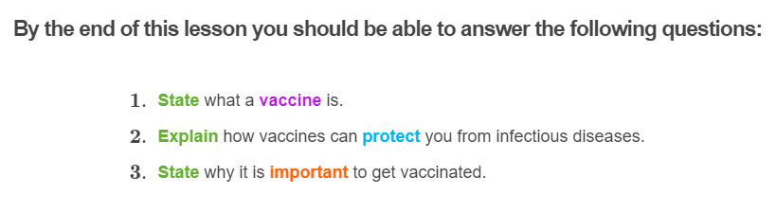
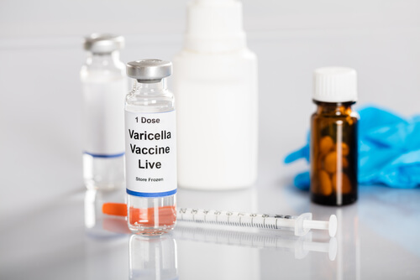

Slide 3
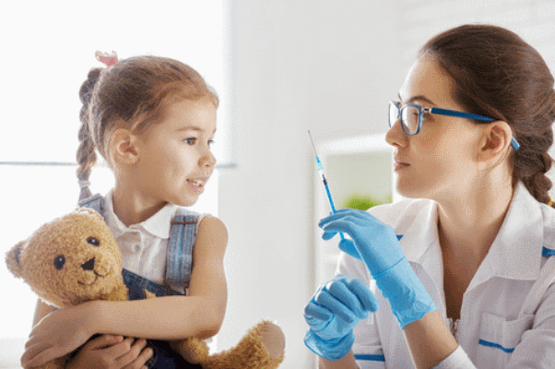
Antibiotics cannot be used to prevent disease, only treat it.
Vaccination is extremely effective at preventing the spread of viral diseases, and some bacterial diseases.

Slide 4
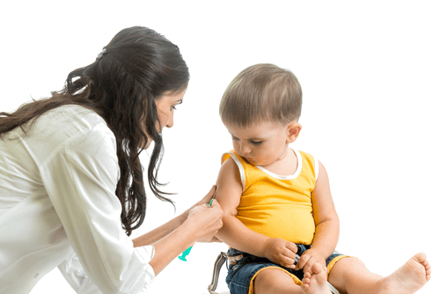
Vaccines
Vaccination involves giving (usually by injection) a person a vaccine.
A vaccine is a product that contains either a weakened or killed version of a particular pathogen.

Slide 5
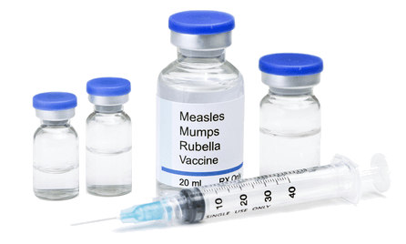
A vaccine trains the immune system to recognise and remember a specific pathogen.
The vaccine essentially stimulates the immune system (the body system that helps you to fight off pathogens and disease) and teaches the immune system to recognise and fight off the pathogen.
This means that when the immune system encounters the actual pathogen, it can effectively fight it off so that the person doesn't get sick. The person is now immune to the disease - they have developed immunity.

Slide 6
Normally, whenever a pathogen enters your body, the cells of your immune system are activated and begin to fight the pathogen.
Pathogens display proteins on their surface called antigens. Antigens are foreign molecules that trigger an immune response.
Immune cells can then produce antibodies, amongst many other immune molecules. These antibodies help to identify and remove the pathogens from the body.

Slide 7
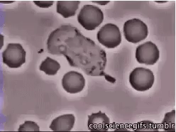
The cells of the immune system (immune cells) learn to recognise specific antigens.
This means that if the same pathogen enters the body again, the cells can fight it off effectively.

Slide 8
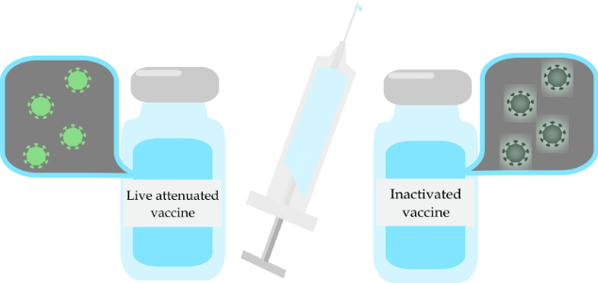
There are many different types of vaccines.
Two of the most common type of vaccines are:
• | Live attenuated vaccines
• | Inactivated vaccines

Slide 9
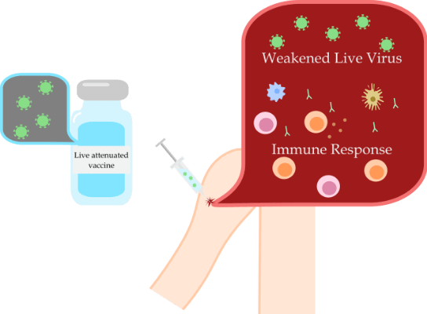
Live attenuated vaccines are made of a weakened version of the actual pathogen.
They are weakened so that the pathogen does not cause the body to develop the actual disease. However, they still trigger the immune response, teaching the body to recognise and attack the pathogen.

Slide 10
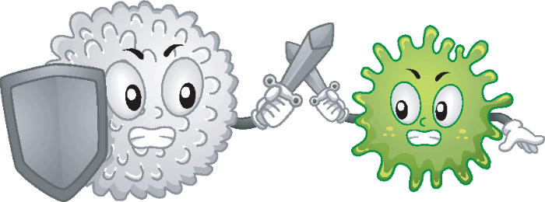
Live attenuated vaccines are more effective than inactivated vaccines.
This is because the pathogen is more powerful so it elicits a strong immune response.
The next time the immune system encounters the pathogen, it knows exactly how to attack it. Immunity to the pathogen also lasts longer.

Slide 11
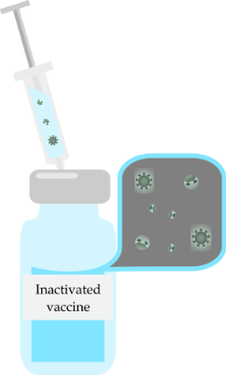
Inactivated vaccines are made of either whole or parts of pathogens that have been killed.
An advantage of these over live attenuated vaccines is that they can be given to people with weakened immune systems.
However, they don't usually create long-lasting immunity, so booster shots (extra doses of the vaccine given after a period of time) are needed.

Slide 12
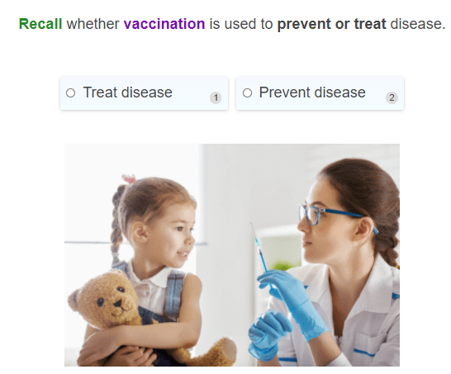

Slide 13
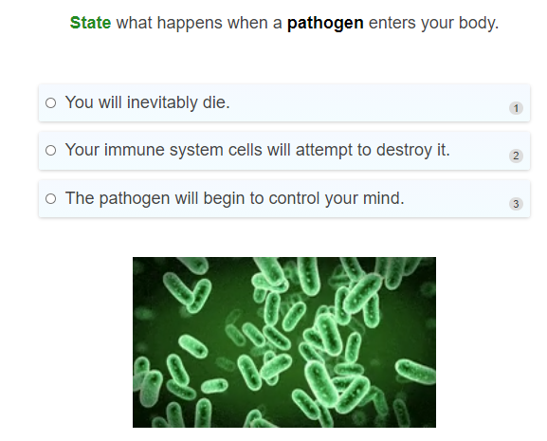

Slide 14
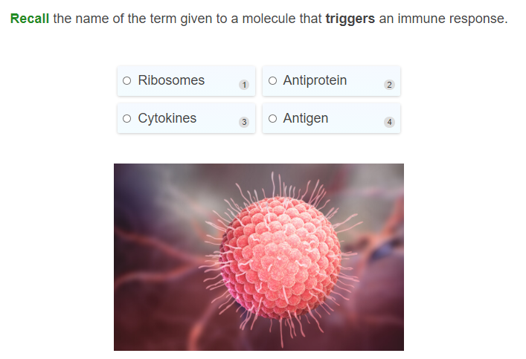

Slide 15
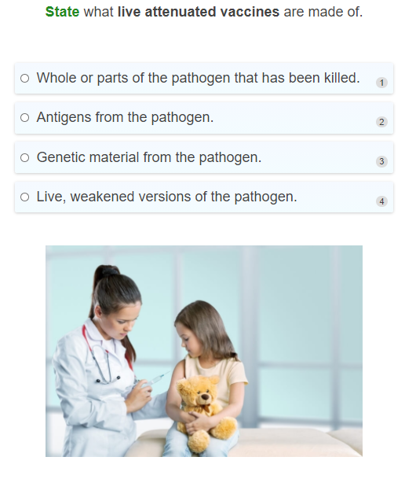

Slide 16
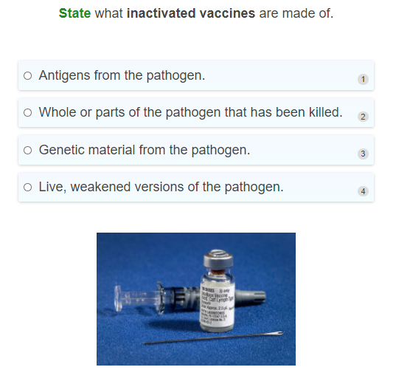

Slide 17
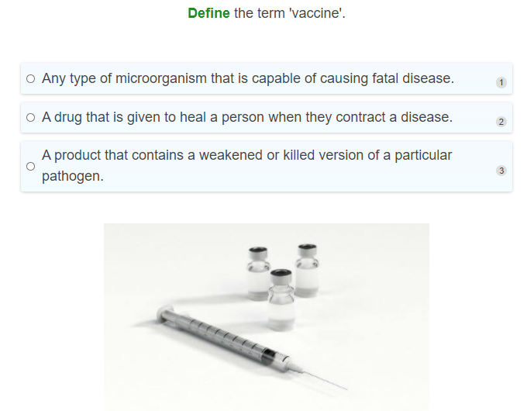

Slide 18
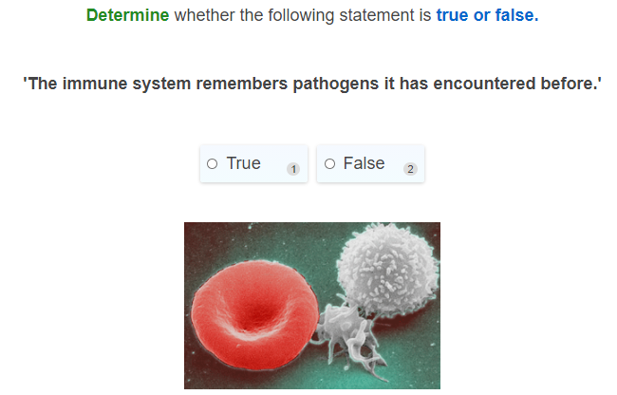

Slide 19
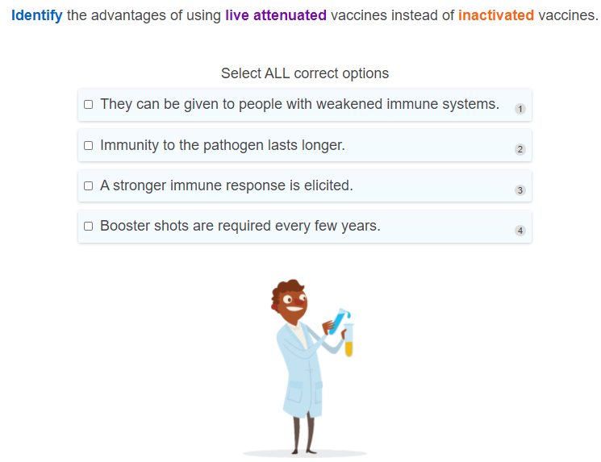

Slide 20
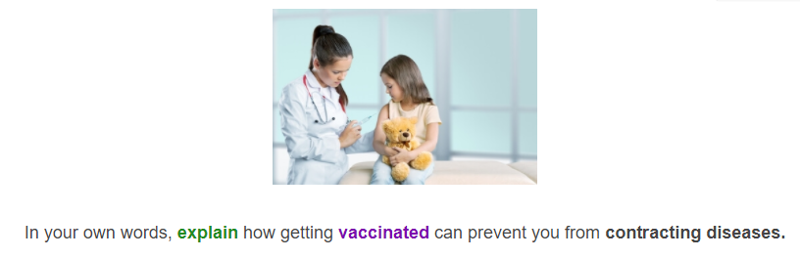

Slide 21
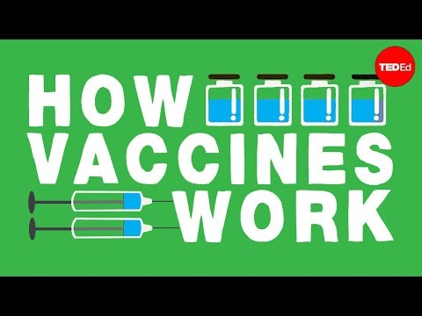

Slide 22
Vaccination is the safest and most effective way of preventing the spread of harmful diseases.
In Australia, the National Immunisation Program provides free childhood vaccinations for many diseases such as diphtheria, measles, mumps, rubella, meningitis, whooping cough, polio and tetanus.

Slide 23
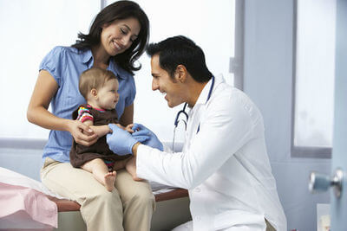
It is very important that every person who is able to get vaccinated does so.
This is because of something called herd immunity, which protects individuals in society who are unable to be vaccinated, such as babies and people with weakened immune systems.

Slide 24
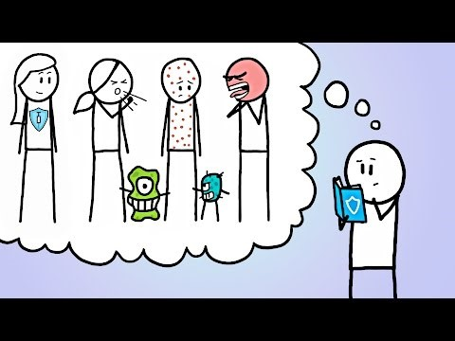

Slide 25
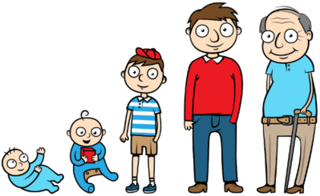
Herd immunity is a form of immunity that occurs when a large enough number of people in a population have been vaccinated against a disease.
When a high proportion of the population is immune to a disease, it is difficult for the disease to spread because there are so few susceptible people to infect.
This can effectively stop the spread of disease through the population, protecting those who are unable to be vaccinated.

Slide 26
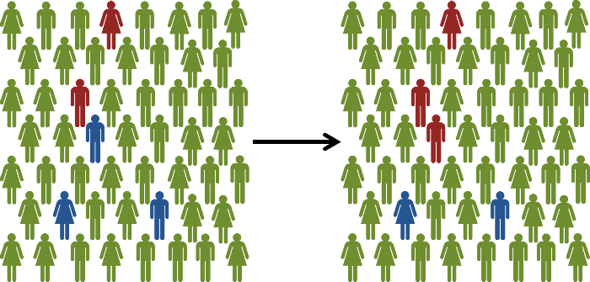
Herd immunity only works if enough people in the population have been vaccinated.
The threshold to achieve herd immunity is different for different diseases, but is usually around 90%. If less than 90% of people have been vaccinated, it makes the vulnerable people in the population more likely to contract the disease.
Situation 1: 90% of people in the population are vaccinated (green). Some people are unvaccinated (blue). The disease spreads to some people (red), but is contained.

Slide 27
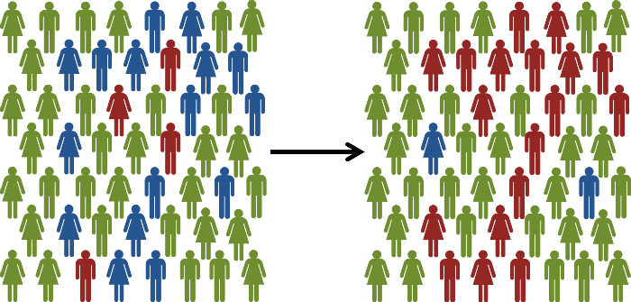
Situation 2: If only 70% of people in the population are vaccinated (green). (Unvaccinated people are shown in blue). The disease spreads to many more people in the population (red).

Slide 28
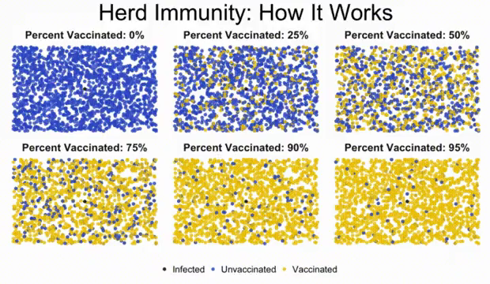
Herd immunity also only works for infectious diseases - diseases that can be spread between people.
It doesn't work for diseases like tetanus, which is contracted from bacteria in the environment. You will not be protected from tetanus if other people around you have been vaccinated, only if you have been vaccinated yourself.

Slide 29
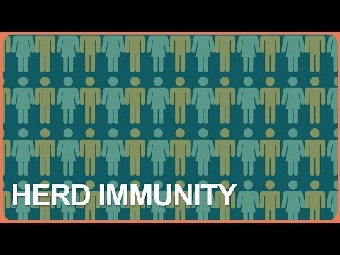

Slide 30
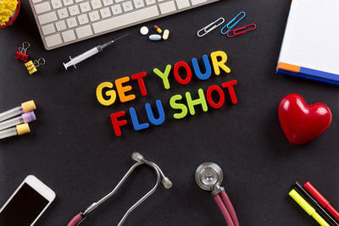
Are you vaccinated?
To protect the vulnerable people in your community, like young babies, elderly people, and those unable to get vaccinated for medical reasons, do your part and get vaccinated!
This includes getting vaccines that need to be taken every year, like the influenza (flu) vaccine.

Slide 31
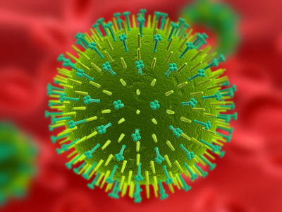
The reason you need to get the flu vaccine every year is because the influenza virus rapidly changes.
It can adapt in order to get past the immune system and infect your cells, so the vaccine needs to be changed every year to protect you from the new form of the virus.
The flu is not just a bad cold - it is a serious illness that can lead to complications like pneumonia and even death in some people. It may seem annoying to get the flu shot every year, but you should get it to protect yourself and those around you.

Slide 32
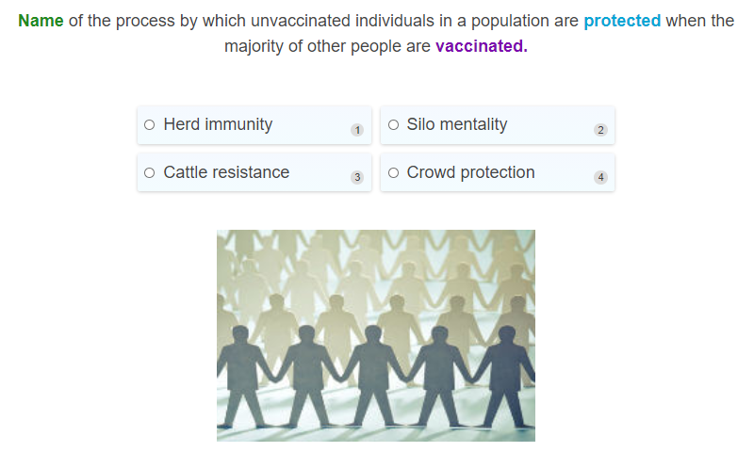

Slide 33
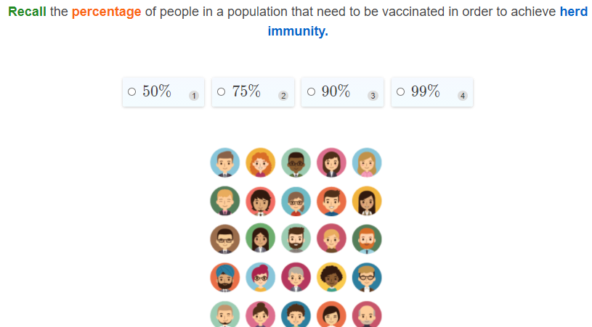

Slide 34
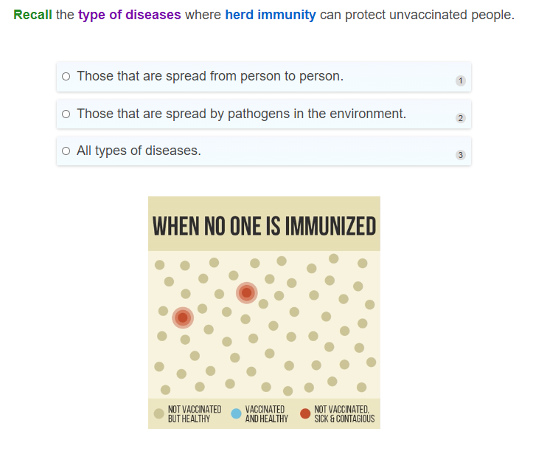

Slide 35
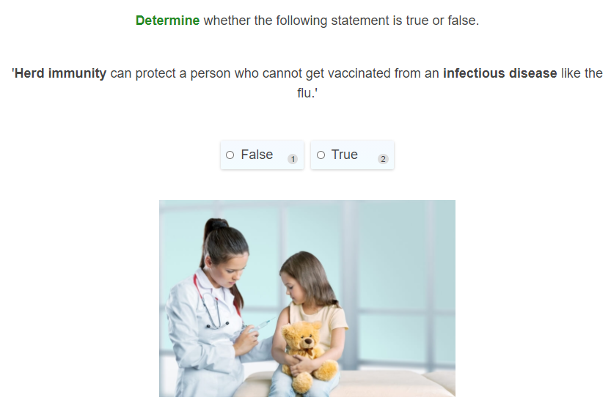

Slide 36
